Slide 1
Introduction
Prepared By
Dr. Vikas Lamba
Chitkara University Institute of Engineering and Technology,
Chitkara University, Punjab

Slide 2
Content
Introduction to Operating systems
Operating System role
Computer system architecture
Single processor
Multiprocessor Systems
Clustered Systems
OS structure
OS operations
Components of OS
Process management
Memory management
Storage management
I/O management

Slide 3
Introduction to Operating systems
An operating system acts as an intermediary between the user of a computer and computer hardware. The purpose of an operating system is to provide an environment in which a user can execute programs conveniently and efficiently.
An operating system is software that manages computer hardware. The hardware must provide appropriate mechanisms to ensure the correct operation of the computer system and to prevent user programs from interfering with the proper operation of the system. A more common definition is that the operating system is the one program running at all times on the computer (usually called the kernel), with all else being application programs.
An operating system is concerned with the allocation of resources and services, such as memory, processors, devices, and information. The operating system correspondingly includes programs to manage these resources, such as a traffic controller, a scheduler, a memory management module, I/O programs, and a file system.

Slide 4
Operating System role
Resource Management: The operating system (OS) manages hardware resources such as CPU, memory, disk storage, and input/output devices, ensuring their efficient utilization during model training and testing.
Task Scheduling: The OS schedules tasks, prioritizes processes, and allocates CPU time, ensuring smooth execution of computationally intensive processes like training machine learning models.
Memory Management: It handles memory allocation for storing datasets, models, and intermediate computations, optimizing system performance and avoiding memory overflow.
Parallel Processing Support: Operating systems enable parallel execution through threading and multiprocessing, which is crucial for models that rely on GPUs or multi-core processors.

Slide 5
Cont……..
Driver Support: Provides necessary drivers to interface with hardware components such as GPUs, ensuring compatibility and leveraging hardware acceleration for faster computation.
File System Management: Facilitates efficient data storage, retrieval, and management of large datasets used in machine learning and deep learning workflows.
Error Handling: Detects and manages system errors, ensuring the reliability and stability of processes during long training sessions or simulations.
Security: Offers secure environments to protect sensitive datasets and ensures safe execution of applications, preventing unauthorized access.
Networking: Provides support for data transfer and communication in distributed computing environments or cloud-based machine learning workflows.
User Interface and Automation: Allows seamless user interaction through graphical interfaces or command-line tools, enabling efficient model execution and result analysis.

Slide 6
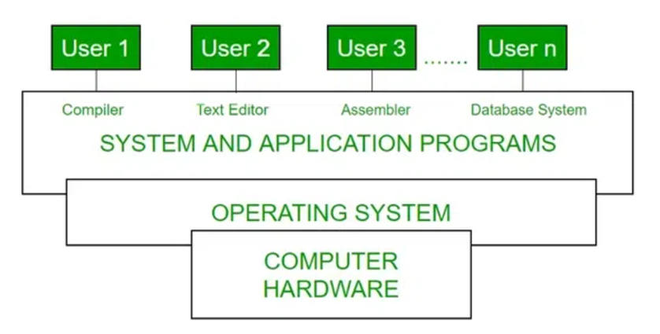
Computer system architecture
The process operating system as User Interface:
User
System and application programs
Operating system
Hardware
Figure 1. Conceptual View of Computer System
Notes:
System software provides a platform for other software to run, while application software performs specific tasks for the user

Slide 7
Cont…….
Every general-purpose computer consists of hardware, an operating system(s), system programs, and application programs. The hardware consists of memory, CPU, ALU, I/O devices, peripheral devices, and storage devices. The system program consists of compilers, loaders, editors, OS, etc. The application program consists of business programs and database programs.
Every computer must have an operating system to run other programs. The operating system coordinates the use of the hardware among the various system programs and application programs for various users. It simply provides an environment within which other programs can do useful work.
The operating system is a set of special programs that run on a computer system that allows it to work properly. It performs basic tasks such as recognizing input from the keyboard, keeping track of files and directories on the disk, sending output to the display screen, and controlling peripheral devices.

Slide 8
Single Processor System
A single processor system refers to a computer system that contains only one central processing unit (CPU) responsible for executing all tasks. It performs operations such as arithmetic, logic, control, and input/output (I/O) management in a sequential manner.
Key Characteristics:
Sequential Task Execution: Only one task or instruction is executed at any given moment.
Resource Management: A single CPU manages all resources, including memory, storage, and I/O devices.
Simplicity: Design and implementation are straightforward compared to multi-processor systems.
Performance: Suitable for tasks that don't require high computational power or parallel processing.

Slide 9
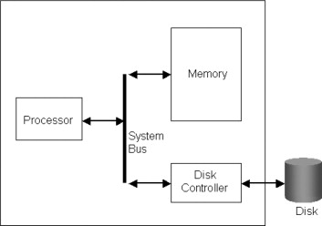
Figure 3: Single-Processor operating system
The diagram typically includes:
Disk Controller: The disk controller is a hardware component that manages the communication between the CPU and storage devices (e.g., hard drives or SSDs).
Memory (RAM): Temporary storage for running applications and active processes.
Input/Output Devices: Devices like keyboards, monitors, and storage drives connected to the system.
Bus: Communication channel connecting the CPU, memory, and I/O devices.

Slide 10
Advantages of Single Processor Systems
Simplicity: Single processor systems are easier to design, implement, and maintain due to their straightforward architecture.
Cost-Effective: They are typically less expensive than multi-processor systems, making them ideal for personal and small-scale applications.
Power Efficiency: These systems consume less power compared to multi-processor systems, suitable for energy-constrained environments.
Ease of Debugging: Debugging and troubleshooting are simpler because of the centralized control and absence of inter-processor communication.
Low Latency: Single processor systems can process tasks without the overhead of managing communication between multiple processors. (low delay to respond)

Slide 11
Disadvantages of Single Processor Systems
Limited Performance: Single processors have limited computational capacity, making them unsuitable for high-performance or parallel-processing tasks.
Scalability Issues: They cannot handle increased workloads effectively compared to multi-processor or distributed systems.
Resource Contention (delay of task performance): With one CPU, all tasks must share the same resources, leading to potential bottlenecks.
Single Point of Failure: If the processor fails, the entire system becomes inoperable, unlike multi-processor systems with redundancy.
Inability to Handle Concurrent Tasks: Multitasking relies on time-sharing rather than true parallelism, which can result in slower processing of simultaneous tasks.

Slide 12
Applications
Single processor systems are commonly used in personal computers, small-scale servers, and embedded systems where performance demands are moderate, and cost-effectiveness is a priority.

Slide 13
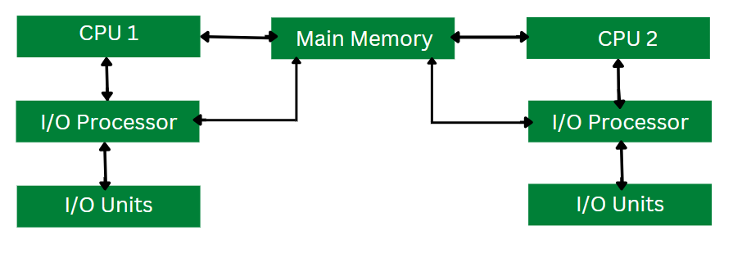
Multiprocessor Systems
A multiprocessor operating system supports a system with multiple CPUs working together to perform tasks. These systems are designed to manage and coordinate the CPUs efficiently, ensuring optimized use of resources, improved performance, and fault tolerance.
Figure 4: Working of Multiprocessing Operating System

Slide 14
Working of Multi-Processing System
Multi-processing operating system consists of multiple CPUs. Each CPU is connected to the main memory.
The task to be performed is divided among all the processors.
For faster execution and improved performance, each processor is assigned a specific task.
Once all the tasks of each processor are completed they are compiled together in order to produce a single output.
The allocation of resources for each processor is handled by the operating system. This process results in better utilization of the available resources and improved performance.

Slide 15
Key Features of Multiprocessor OS Systems
Symmetric Multiprocessing (SMP): All processors share the same memory and are treated equally by the OS.
Asymmetric Multiprocessing (AMP): Processors are assigned specific tasks, with one acting as a master to control the others.
Concurrency: Ability to execute multiple processes simultaneously by distributing workloads across processors.
Shared Memory Access: Processors access a common memory space, enabling communication and synchronization.
Load Balancing: The OS distributes tasks evenly among processors to avoid overloading any single CPU.

Slide 16
Advantages of Multiprocessor OS Systems
Improved Performance: Tasks are divided among processors, reducing execution time and enhancing throughput.
Fault Tolerance: If one processor fails, the system can continue functioning with the remaining processors.
Scalability: Additional processors can be added to improve performance as the workload grows.
True Parallel Processing: Enables simultaneous execution of multiple tasks, suitable for compute-intensive applications.
Resource Sharing: Shared memory allows efficient resource utilization and inter-process communication.

Slide 17
Disadvantages of Multiprocessor OS Systems
Complexity: Designing and managing multiprocessor systems is more challenging than single-processor systems.
Cost: Multiprocessor systems are expensive due to additional hardware and software complexity.
Synchronization Issues: Shared memory and resource access can lead to contention and require complex synchronization mechanisms.
Overhead: Communication between processors can add overhead, reducing efficiency in some scenarios.
Dependency on Software: Performance gains depend on the software being optimized for parallel execution.

Slide 18
Applications of Multiprocessor OS Systems
High-Performance Computing (HPC): Used in supercomputers for scientific research, simulations, and complex computations.
Data Centers: Multiprocessor systems power servers handling large-scale web services, databases, and cloud computing.
Gaming Consoles: Modern gaming consoles use multiprocessor systems for rendering high-quality graphics and gameplay.
AI and Machine Learning: Used to accelerate training and inference tasks in deep learning models.
Real-Time Systems: Found in automotive and industrial control systems requiring high reliability and quick responses.

Slide 19
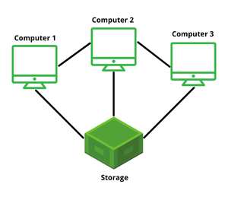
Clustered Systems
Clustered operating systems are designed to manage and coordinate multiple computers (or nodes) working together as a unified system(single system). These systems use clusters of interconnected machines to achieve high availability, scalability, and performance.
Figure 5: Clustered Operating System

Slide 20
Key Features of Clustered OS
Node-Based Architecture: Multiple computers, or nodes, are connected to form a cluster. Each node runs its own OS but is coordinated to act as a single unit.
High Availability: If one node fails, others in the cluster take over, ensuring uninterrupted service.
Scalability: Nodes can be added or removed as needed, making it easier to handle growing workloads.
Load Balancing: Tasks are distributed across nodes to prevent any single node from being overload.
Redundancy(availability): Data and processes are replicated(copy of data) across nodes to prevent data loss and enable fault tolerance.
Interconnect Network: Nodes communicate through high-speed networks such as Ethernet.

Slide 21
Types of Clustered OS
High-Performance Clusters (HPC): Designed for computationally intensive tasks, such as simulations and scientific research.
High-Availability Clusters (HA): Focused on ensuring uptime and reliability, often used for critical applications like databases.
Load-Balancing Clusters: Distribute workloads among nodes for improved performance, common in web services.

Slide 22
Advantages of Clustered OS
Fault Tolerance: Redundant nodes ensure continuous service even in case of hardware or software failure.
Scalability: Nodes can be easily added to accommodate increased workloads.
Improved Performance: Tasks are divided among multiple nodes, enhancing processing power and speed.
Cost-Effective: Using commodity hardware reduces costs compared to building supercomputers.
Flexibility: Nodes can be configured and reconfigured based on the application’s requirements.

Slide 23
Disadvantages of Clustered OS
Complex Management: Managing and configuring clusters can be challenging, especially as the number of nodes increases.
Cost of Setup: Requires high-speed networks and specialized software, which can be expensive.
Synchronization Overhead: Ensuring consistency across nodes can introduce latency.
Dependency on Interconnects: Performance heavily depends on the speed and reliability of the interconnect network.

Slide 24
Applications of Clustered OS
Data Centers: Used for hosting cloud services and handling large-scale data processing.
Scientific Research: Perform complex computations and simulations in areas like weather prediction and molecular modeling.
Web Servers: Enable load balancing and high availability for e-commerce and web hosting.
Big Data Analytics: Handle distributed processing of massive datasets(banking), such as in Hadoop or Apache Spark clusters.
Enterprise Systems: Support critical business applications requiring high reliability and scalability.

Slide 25
Operating Systems Structures
A system structure for an operating system is like the blueprint of how an OS is organized and how its different parts interact with each other. Because operating systems have complex structures, we want a structure that is easy to understand so that we can adapt an operating system to meet our specific needs.
Similar to how we break down larger problems into smaller, more manageable sub problems, building an operating system in pieces is simpler.
The strategy for integrating different operating system components within the kernel can be thought of as an operating system structure.
Kernel manages the system resources and enable communication between h/w and s/w. it manages memory, cpu scheduling, i/p and o/p devices mgmt, process control and system security.

Slide 26
Types of Operating Systems Structures
Depending on this, we have the following structures in the operating system:
Simple Structure
Monolithic Structure
Micro-Kernel Structure
Hybrid-Kernel Structure
Exo-Kernel Structure
Layered Structure
Modular Structure
Virtual Machines

Slide 27
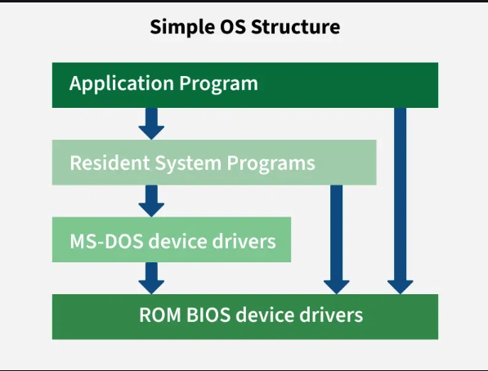
Simple Structure
Simple structure operating systems do not have well-defined structures and are small, simple, and limited. The interfaces and levels of functionality are not well separated. MS-DOS is an example of such an operating system. In MS-DOS, application programs are able to access the basic I/O routines. These types of operating systems cause the entire system to crash if one of the user programs fails.
Figure 6: Simple Structure of OS

Slide 28
Cont…….
Advantages of Simple Structure
It delivers better application performance because of the few interfaces between the application program and the hardware.
It is easy for kernel developers to develop such an operating system.
Disadvantages of Simple Structure
The coding structure is very complicated, as no clear boundaries exist between modules.
It does not enforce data hiding in the operating system.

Slide 29
Monolithic Structure
A monolithic structure is a type of operating system architecture where the entire operating system is implemented as a single large process in kernel mode. Essential operating system services, such as process management, memory management, file systems, and device drivers, are combined into a single code block.
IBM’s AIX, older version of Linux kernel.
Advantages of Monolithic Structure
Performance of Monolithic structure is fast as since everything runs in a single block, therefore communication between components is quick.
It is easier to build because all parts are in one code block.
Disadvantages of Monolithic Architecture
It is hard to maintain as a small error can affect entire system.
There are also some security risks in the Monolithic architecture.
less secure then macro kernel OS.

Slide 30
Micro-Kernel Structure
Micro-Kernel structure designs the operating system by removing all non-essential components from the kernel and implementing them as system and user programs. This results in a smaller kernel called the micro-kernel. Advantages of this structure are that all new services need to be added to user space and does not require the kernel to be modified. Thus it is more secure and reliable as if a service fails, then rest of the operating system remains untouched. Mac OS is an example of this type of OS.
Advantages of Micro-kernel Structure
It makes the operating system portable to various platforms.
As micro kernels are small so these can be tested effectively.
Disadvantages of Micro-kernel Structure
Increased level of inter module communication degrades system performance.

Slide 31
Hybrid-Kernel Structure
Hybrid-Kernel structure is nothing but just a combination of both monolithic-kernel structure and micro-kernel structure. Basically, it combines properties of both monolithic and micro-kernel and make a more advance and helpful approach. It implement speed and design of monolithic and modularity and stability of micro-kernel structure. Additional services(drivers) can run in user space (where app runs i.e. main memory)
Examples: Window 10, 11, server and macOS, iOS, BeOS
Advantages of Hybrid-Kernel Structure
It offers good performance as it implements the advantages of both structure in it.
It supports a wide range of hardware and applications.
It provides better isolation and security by implementing micro-kernel approach.
It enhances overall system reliability by separating critical functions into micro-kernel for debugging and maintenance.
Disadvantages of Hybrid-Kernel Structure
It increases overall complexity of system by implementing both structure (monolithic and micro) and making the system difficult to understand.
The layer of communication between micro-kernel and other component increases time complexity and decreases performance compared to monolithic kernel.

Slide 32
Exo-Kernel Structure
An Exo-kernel(minimal) operating system kernel provides very little abstraction as possible, allowing applications to directly manage hardware resources. Unlike traditional monolithic, microkernel, or hybrid kernels, exo-kernels delegate most OS functionality to user-space libraries, giving applications more control and flexibility.
Examples of Exokernel-based Operating Systems:
1. ExOS:A research operating system developed at MIT alongside the Exokernel project.
2. Nemesis:An operating system designed for multimedia applications, emphasizing resource isolation and direct hardware management.

Slide 33
Cont….
Advantages of Exo-Kernel
Support for improved application control.
Separates management from security.
It improves the performance of the application.
A more efficient use of hardware resources is made possible by accurate resource allocation.
It is simpler to test and create new operating systems.
Each user-space program is allowed to use a custom memory management system.
Disadvantages of Exo-Kernel
Exokernel interfaces have a complex architecture.

Slide 34
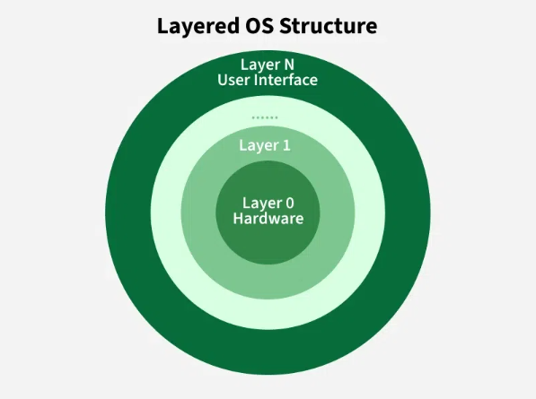
Layered Structure
An OS can be broken into pieces and retain much more control over the system. In this structure, the OS is broken into a number of layers leyer0,1,2,3,4,5 ()etc. (levels).
Layer 0: Hardware (CPU, memory, and I/O devices.)
Layer 1: Hardware Abstraction (e.g., managing interrupts, device drivers, etc.)
Layer 2: Kernel (Core OS Functions) (Manages essential system resources such as CPU scheduling)
Layer 3: System Utilities (services like file systems, device drivers, and networking protocols.)
Layer 4: User-Level Services (Includes system calls and APIs) and Layer 5: User Applications
The main disadvantage of this structure is that at each layer, the data needs to be modified and passed on which adds overhead to the system. Moreover, careful planning of the layers is necessary, as a layer can use only lower-level layers. UNIX is an example of this structure.
Figure 7: Layered OS

Slide 35
Cont…….
Advantages of Layered Structure
Layering makes it easier to enhance the operating system, as the implementation of a layer can be changed easily without affecting the other layers.
It is very easy to perform debugging and system verification.
Disadvantages of Layered Structure
In this structure, the application’s performance is degraded as compared to simple structure.
It requires careful planning for designing the layers, as the higher layers use the functionalities of only the lower layers.

Slide 36
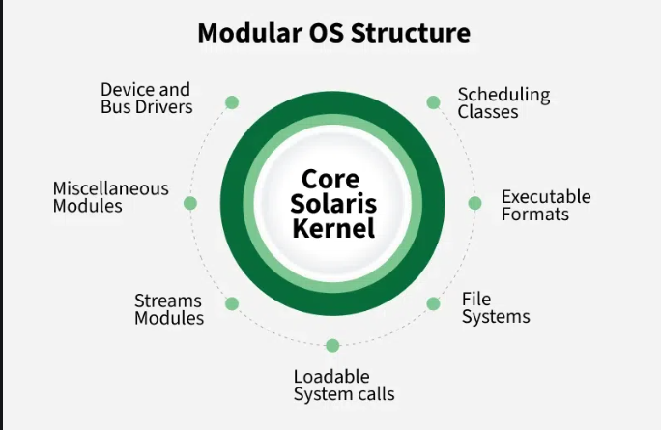
Modular Structure
It is considered as the best approach for an OS. It involves designing of a modular kernel. A modular structure in an operating system refers to a design approach where the OS is divided into separate, independent modules, each responsible for a specific functionality. This architecture combines the benefits of monolithic and microkernel systems, offering modularity and efficiency.
Example: Linux, Solaris, MacOS etc.
Figure 8:Modular OS Structure

Slide 37
Virtual Machines (VMs)
Based on our needs, a virtual machine abstracts the hardware of our personal computer, including the CPU, disc drives, RAM, and NIC (Network Interface Card), into a variety of different execution contexts, giving us the impression that each execution environment is a different computer. An illustration of it is a virtual box.
An operating system enables us to run multiple processes concurrently while making it appear as though each one is using a different processor and virtual memory by using CPU scheduling and virtual memory techniques.
The fundamental issue with the virtual machine technique is disc systems. Let’s say the physical machine only has three disc drives, but it needs to host seven virtual machines. The program that creates virtual machines would need a significant amount of disc space in order to provide virtual memory and spooling, so it should be clear that it is impossible to assign a disc drive to every virtual machine. The answer is to make virtual discs available.

Slide 38
OS operations
An operating system (OS) is a system software that manages hardware, software resources, and provides services for computer programs. Its operations can be broadly categorized as follows:
1. Process Management
Objective: Manage processes (programs in execution), including their creation, scheduling, and termination.
Operations:
Process creation and termination.
CPU scheduling for efficient process execution.
Synchronization and communication between processes.
Example: Allocating CPU time to multiple running applications, such as a browser and a video player.

Slide 39
Cont…..
2. Memory Management
Objective: Efficiently manage the computer's memory (RAM) for optimal performance.
Operations:
Allocation and de allocation of memory space for programs.
Paging and segmentation for memory organization.
Managing virtual memory to extend RAM using disk space.
Example: Keeping multiple tabs open in a web browser without crashing the system.
.

Slide 40
Cont…..
3. File System Management
Objective: Manage storage, organization, and retrieval of data in files and directories.
Operations:
File creation, deletion, and modification.
Managing access permissions for security.
File organization in directories for easy navigation.
Example: Storing a Word document in a specific folder

Slide 41
Cont……
4. Device Management
Objective: Coordinate the use of input/output devices like keyboards, printers, and storage drives.
Operations:
Managing device drivers for hardware interaction.
Buffering and spooling for efficient data handling.
Handling device communication via interrupt service routines (ISRs).
Example: Printing a document while continuing to work on other tasks.

Slide 42
Cont……
5. User Interface Management
Objective: Provide a user interface (UI) to interact with the system.
Operations:
Graphical User Interface (GUI) or Command-Line Interface (CLI).
Managing user sessions and input/output operations.
Example: Using the Windows Start menu or Linux Terminal to launch applications.

Slide 43
Cont……
6. Security and Access Control
Objective: Protect the system and data from unauthorized access or threats.
Operations:
User authentication through passwords or biometrics.
Access permissions for files and system resources.
Protection against malware or unauthorized software.
Example: Restricting file access to specific users

Slide 44
Cont……
7. Networking
Objective: Enable communication between computers in a network.
Operations:
Managing network protocols like TCP/IP.
Resource sharing, such as printers or files, over a network.
Handling data transmission and reception efficiently.
Example: Accessing a shared printer or transferring files via FTP.

Slide 45
Cont……
8. System Performance Monitoring
Objective: Monitor and optimize system performance.
Operations:
Tracking CPU and memory usage.
Managing system logs and diagnostics.
Providing tools for troubleshooting and tuning.
Example: Task Manager in Windows showing running processes and their resource usage.

Slide 46
Cont……
9. Multi-User and Multitasking Management
Objective: Support multiple users and multitasking efficiently.
Operations:
Allocating resources fairly among users.
Enabling multiple applications to run simultaneously.
Example: Running video editing software while browsing the web on a multi-user system.

Slide 47
Cont……
10. System Call Handling
Objective: Provide an interface for programs to request OS services.
Operations:
Handling system calls like file operations, memory allocation, and process control.
Example: A program saving a file invokes a system call to access the file system.
These operations collectively ensure that the OS serves as a bridge between hardware and users, enabling seamless interaction and efficient resource management.

Slide 48
Components of an Operating Systems
There are two fundamental components of an Operating System.
Shell
Kernel
Shell
Shell is the outermost layer of the Operating System and it handles the interaction with the user. The main task of the Shell is the management of interaction between the User and OS. Shell provides better communication with the user and the Operating System Shell does it by giving proper input to the user it also interprets input for the OS and handles the output from the OS. It works as a way of communication between the User and the OS.
Kernel
The kernel is one of the components of the Operating System which works as a core component. The rest of the components depends on Kernel for the supply of the important services that are provided by the Operating System. The kernel is the primary interface between the Operating system and Hardware.

Slide 49
Cont……
Functions of Kernel
It helps in controlling the System Calls.
It helps in I/O Management.
It helps in the management of applications, memory, etc.
Types of Kernel
There are four types of Kernel that are mentioned below.
Monolithic Kernel
Microkernel
Hybrid Kernel
Exokernel

Slide 50
Cont….
There are essential components of an operating system (OS). Here's a breakdown of each component:
Process Management:
This component manages processes (programs in execution), including their creation, scheduling, and termination.
It ensures that processes have enough CPU time to run and that processes do not interfere with each other. It also handles multitasking and context switching.
Key elements: Process scheduling, inter-process communication, process synchronization, and deadlock management.

Slide 51
Cont….
Memory Management:
Memory management is responsible for managing the system's memory (RAM) to ensure efficient use.
It allocates and deallocates memory to processes, ensures that each process has enough memory to run, and prevents processes from accessing each other's memory (providing isolation).
Key elements: Virtual memory, paging, segmentation, memory allocation, and garbage collection.
Storage Management:
This component is in charge of managing data storage, including both primary storage (RAM) and secondary storage (e.g., hard drives, SSDs).
It ensures that data is stored efficiently and can be retrieved quickly and reliably when needed.
Key elements: File systems, disk scheduling, disk management, and data backups.

Slide 52
Cont….
I/O Management:
I/O management controls the input and output operations between the computer system and external devices like keyboards, mice, printers, displays, and storage devices.
It provides a mechanism for reading data from and writing data to I/O devices, handling data transfer between the system and peripherals.
Key elements: Device drivers, buffers, queues, and I/O scheduling.
These components work together to ensure that the operating system functions smoothly, providing an interface for users and managing the underlying hardware efficiently.

